Slide 1

JavaScript
Asynchronous Programming, Rest Controllers
SoftUni Team
Technical Trainers
Software University
https://softuni.bg

Slide 2
Table of Contents
Asynchronous Programming
Fetch
Rest Controllers
2

Slide 3
Have a Question?
sli.do #java-web

Slide 4
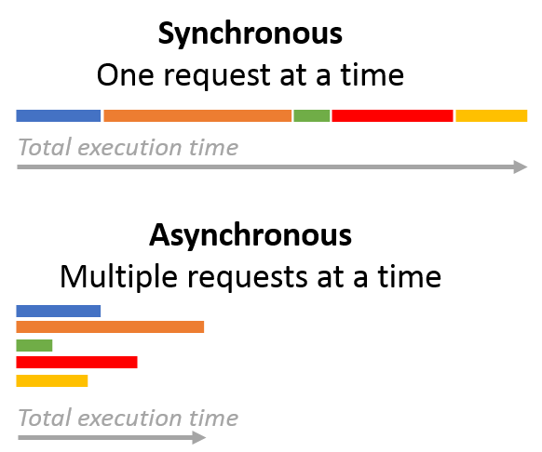
Asynchronous Programming

Slide 5
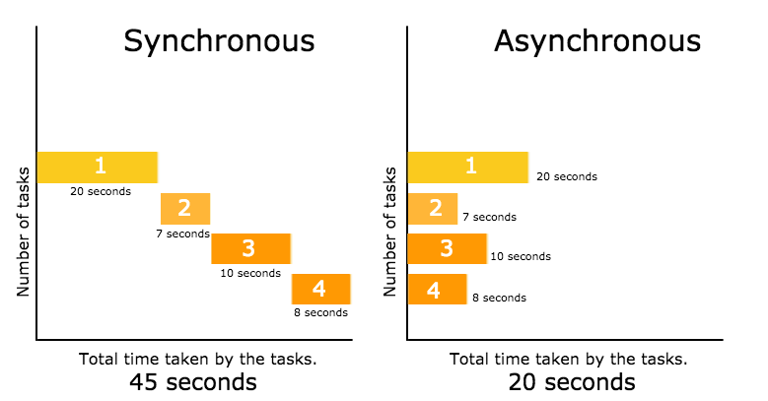
Asynchronous Programming
Asynchronous programming deals with the needs to run several tasks (pieces of code) in parallel, in the same time

Slide 6
Asynchronous Programming
Synchronous programming
Each line of code is executed only when the preceding line has finished it’s work
Asynchronous Programming
In asynchronous programs, you can have two lines of code (L1 followed by L2), where L1 schedules some task to be run in the future, but L2 runs before that task completes
The tasks may finish in order of execution but it is not guaranteed

Slide 7
Asynchronous Programming – Example
What is wrong with these examples?
// Say "Hello."
console.log('Hello.');
// Say "Goodbye" two seconds from now.
setTimeout(function() {
console.log('Goodbye!');
}, 2000);
// Say "Hello again!"
console.log('Hello again!');
function getData() {
var data;
$.get('example.php', function(response) {
data = response;
}
);
return data;
}
var data = getData();
console.log('The data is: ' + data);

Slide 8

Fetch API

Slide 9
Fetch API
Fetch provides a generic definition of Request and Response objects
Fetch API allows you to make network requests similar to XMLHttpRequest (XHR).
The response of a fetch() is a Stream object.

Slide 10

Fetch API (Demo)
@GetMapping("/")
public ModelAndView index(ModelAndView modelAndView) {
modelAndView.setViewName("index");
return modelAndView;
}
@GetMapping(value = "/fetch", produces = "application/json")
@ResponseBody
public Object fetchData() {
return new ArrayList<Product>() {{
add(new Product(){{
setName("Chewing Gum");
setPrice(new BigDecimal(1.00));
setBarcode("133242556222");
}});
...
}}; }
public class Product {
private String name;
private BigDecimal price;
private String barcode;
// Getters & Setters
...
}
Product.java
HomeController.java

Slide 11
Fetch API (Demo)
Now let’s head to the view
There is no need for a separate .js file for one-time use
...
<div class="container-fluid">
<h1 class="text-center mt-5 display-1">Data Fetch</h1>
<div class="data-container mt-5"></div>
<div class="button-holder mt-5">
<button id="fetch-button" class="btn btn-info">Fetch Data</button>
<button id="clear-button" class="btn btn-secondary">Clear Data</button>
</div>
</div>
<script>
// jQuery Event handlers
$('#fetch-button').click(() => {...}); // Fetch and render the data
$('#clear-button').click(() => $('.data-container').empty()); // Clear the data
</script>
index.html

Slide 12
Fetch API (Demo)
$('#fetch-button').click(() => {
fetch('http://localhost:8000/fetch') // Fetch the data (GET request)
.then((response) => response.json()) // Extract the JSON from the Response
.then((json) => json.forEach((x, y) => { // Render the JSON data to the HTML
if (y % 4 === 0) {
$('.data-container').append('<div class="row d-flex justify-content-around mt-4">');
}
let divColumn =
'<div class="col-md-3">' +
'<h3 class="text-center font-weight-bold">' + x.name + '</h3>' +
'<h4 class="text-center">Price: $' + x.price + '</h4>' +
'<h4 class="text-center">Barcode: $' + x.barcode + '</h4>' +
'</div>';
$('.data-container .row:last-child').append(divColumn);
}));
});

Slide 13

Rest Controllers

Slide 14
Rest Controller
@RestController is a specialized version of the controller.
It includes the @Controller and @ResponseBody annotations and as a result, simplifies the controller implementation:
@RestController
@RequestMapping("/item")
public class ItemController {
//TODO add the repository
@GetMapping("/{id}", produces="/application/json")
public Item getItemById(@PathVaraible int id) {
return itemRepository.findById(id);
}
}

Slide 15

Summary
Asynchronous programming deals with the needs to run several tasks (pieces of code) in parallel
Fetch provides a generic definition of Request and Response objects

Slide 16
https://softuni.bg/courses/spring-mvc

Slide 17












SoftUni Diamond Partners

Slide 18




SoftUni Organizational Partners

Slide 19




Trainings @ Software University (SoftUni)
Software University – High-Quality Education and Employment Opportunities
softuni.bg
Software University Foundation
http://softuni.foundation/
Software University @ Facebook
facebook.com/SoftwareUniversity
Software University Forums
forum.softuni.bg

Slide 20

License
This course (slides, examples, demos, videos, homework, etc.) is licensed under the "Creative Commons Attribution-NonCommercial-ShareAlike 4.0 International" license

